Slide 1
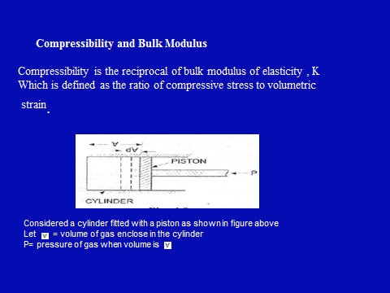
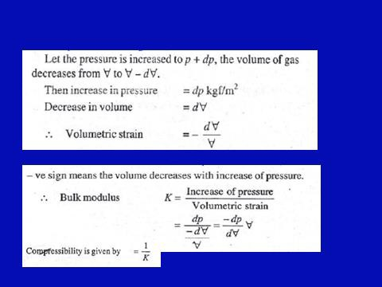
Fluid Mechanics Class Note
Dr. Qassem Hamed Jalut Associate Professor

Slide 2
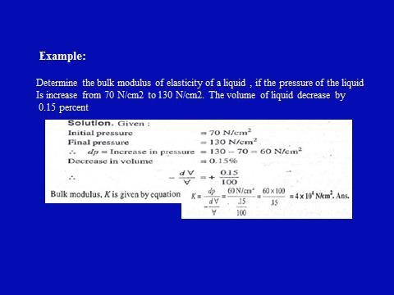
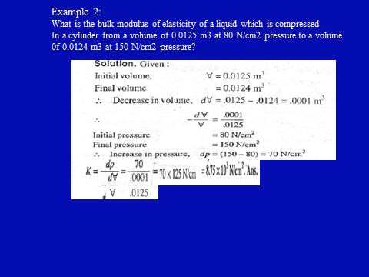
Fluid Mechanics Class Note
Dr. Qassem Hamed Jalut Associate Professor

Slide 3
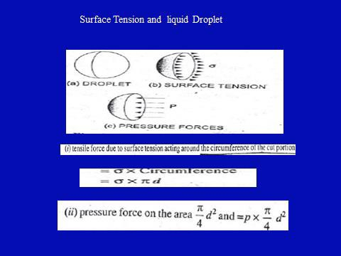
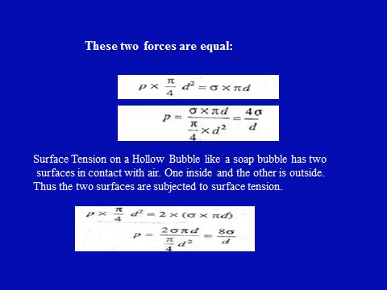
Fluid Mechanics Class Note
Dr. Qassem Hamed Jalut Associate Professor

Slide 4
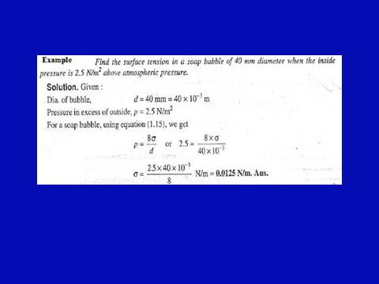
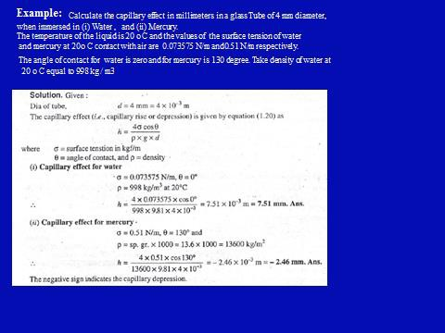
Fluid Mechanics Class Note
Dr. Qassem Hamed Jalut Associate Professor

Slide 5
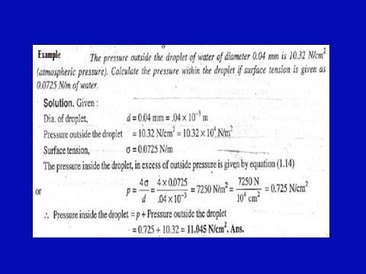
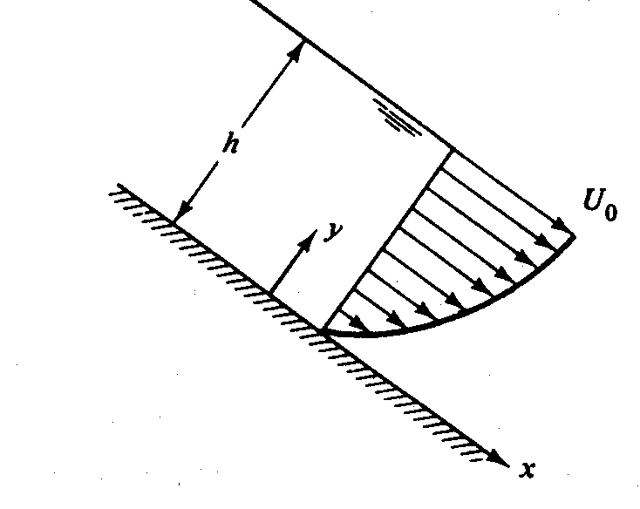
Fluid Mechanics Class Note
Dr. Qassem Hamed Jalut Associate Professor
Extra Examples and Problems
Problem (1)
The velocity profile in water flow down a spillway is given by:
ℎ
1/7
𝑢= 𝑈_{𝑜}( _{𝑦})
If U_{o} = 1.4 m/s , h= 3 m and the width is 17 m, how long will it take
a volume of water equal to 10⁵ m³ to pass this section of the spillway ?
Problem (2)

Slide 6




Fluid Mechanics Class Note
Dr. Qassem Hamed Jalut Associate Professor
A large plate is centrally placed inside a gap which contains two different fluids with ( µ₁ = 4 µ₂ ) . If the force per unit area due to shear acting on both side of plate is 50 N . Calculate the values of viscosity for the two fluids ( i.e µ₁ and µ₂ ) .
µ1
V= o.5 m/sec
6 cm
µ2
Plate

Slide 7

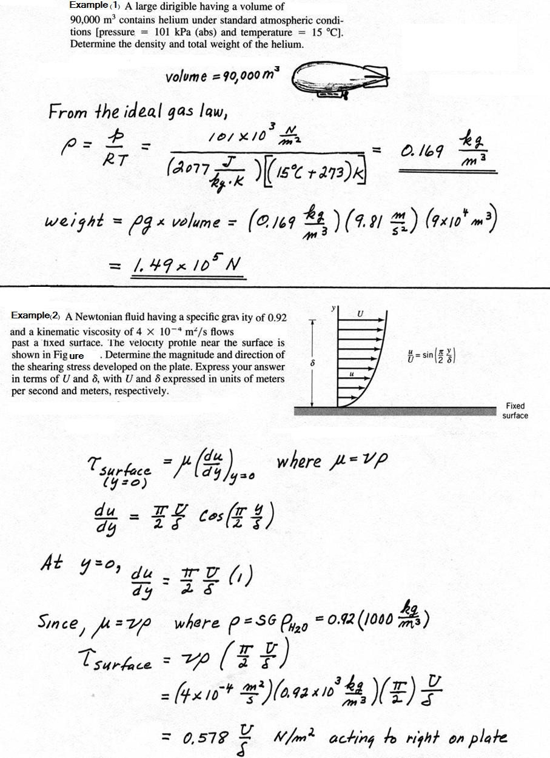
Fluid Mechanics Class Note
Dr. Qassem Hamed Jalut Associate Professor

Slide 8
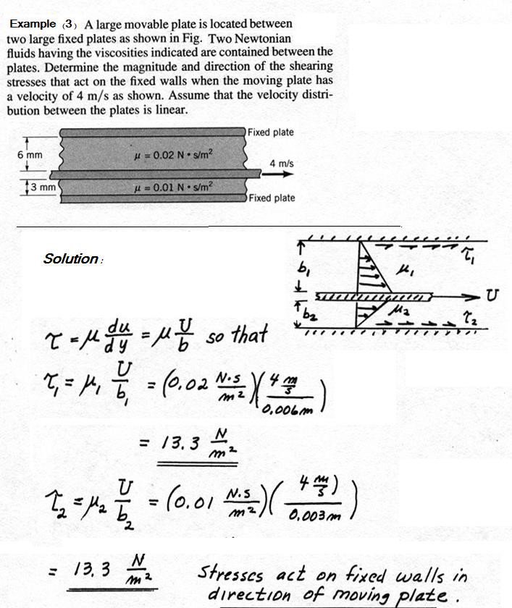
Fluid Mechanics Class Note
Dr. Qassem Hamed Jalut Associate Professor

Slide 9
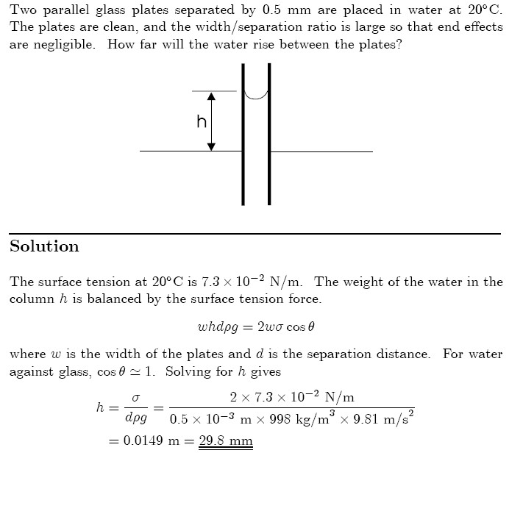
Fluid Mechanics Class Note
Dr. Qassem Hamed Jalut Associate Professor
Example(4)

Slide 10
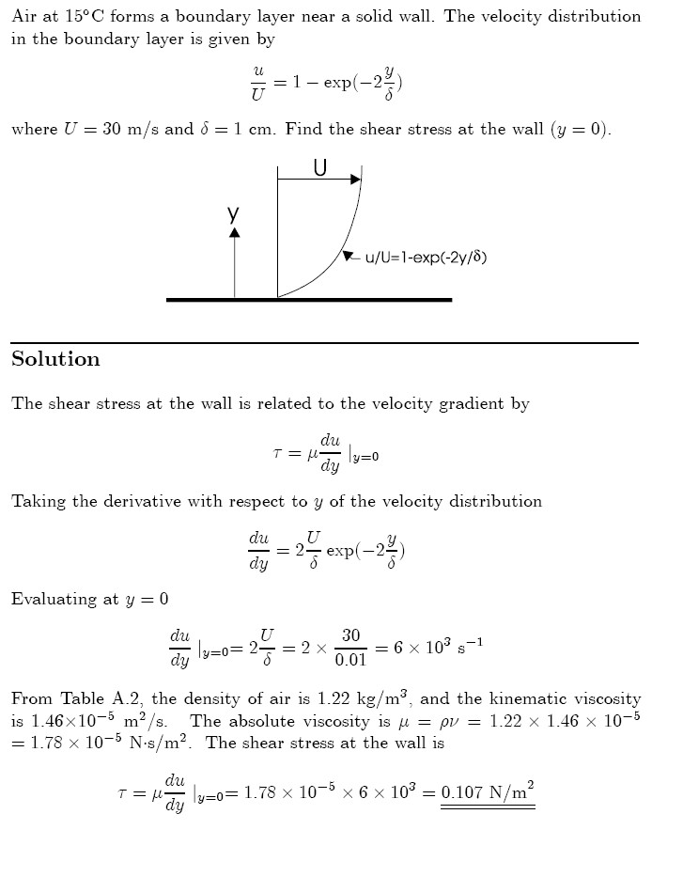
Fluid Mechanics Class Note
Dr. Qassem Hamed Jalut Associate Professor
Example (5)
40

Slide 11
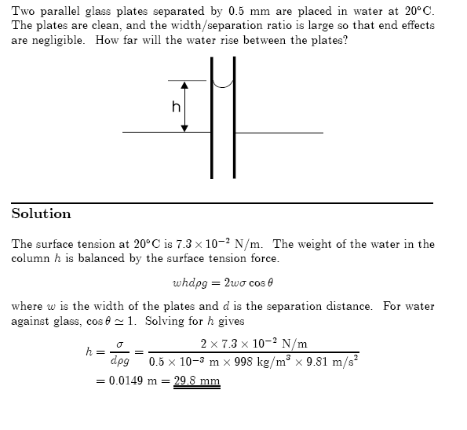
Fluid Mechanics Class Note
Dr. Qassem Hamed Jalut Associate Professor
Example (1)
41

